Slide 1

Iteration 4
Computer Science Project Portal

Slide 2
Iteration 4 Completions
Sign up and create new accounts
Professor/Faculty Distinction implemented
Log in and Log out by user type with password hashing
Complete redesign and responsive design deployed to server
Notes:
J

Slide 3
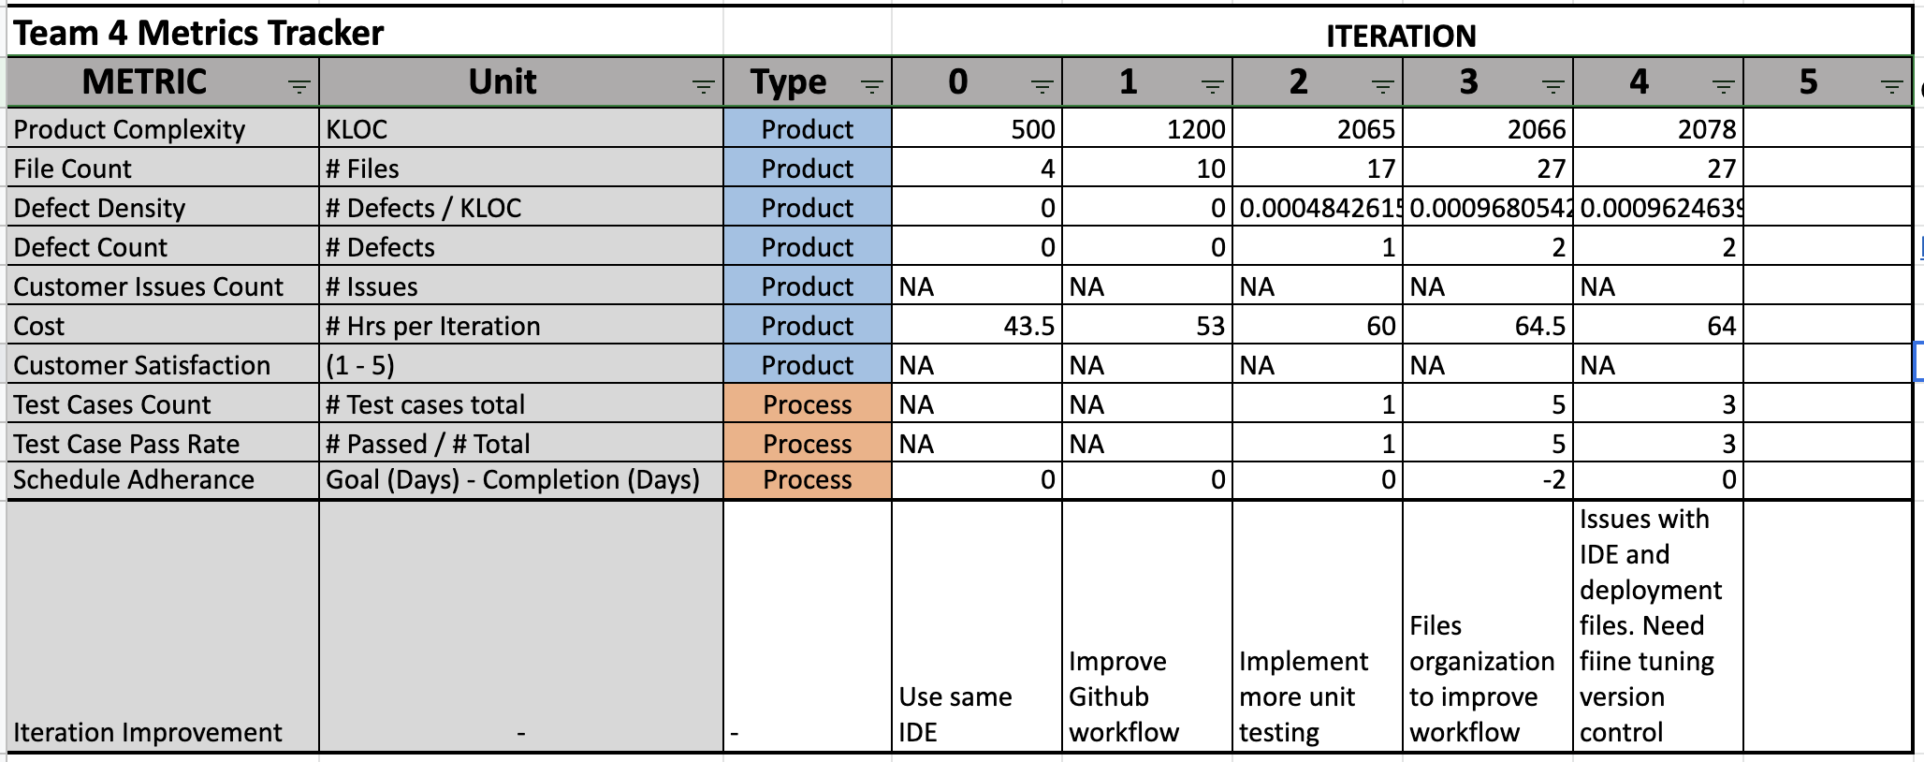
QUALITY METRICS SUMMARY
Notes:
J

Slide 4
Testing Plan
Tools
Selenium
NUnit
Test Cases
Validation Username and Password
Log out functionality
Invalid Username and Password
Notes:
R

Slide 5
Testing Result
Test | User Requirement Addressed | Expected Results | Actual Results | Pass/Fail | Date | Correction Action
Validate Username And Password | Access to the system | Can access if they are authorized users | As expected | Pass | 11/14 | None
Logout | Exit from the system | User can log out from the system | As expected | Not run | 11/14 | Debugging to pass
Invalid Username or Password format | Warning text | User can see the warning notification | As expected | Not run | 11/14 | Debugging to pass
Notes:
R

Slide 6
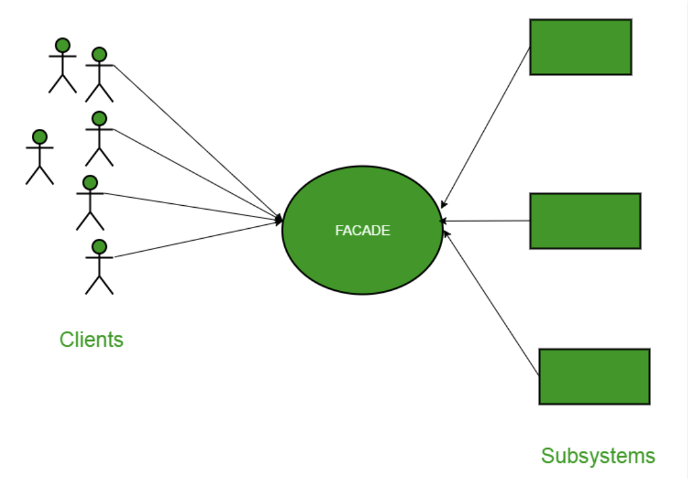
Design Pattern - The Facade
Structural design pattern, the Facade.
There will be two different Facade classes, one for user and one for projects.
Facade Class for Users
Student
Major
Graduation Date
Faculty
Field of Experience
Facade Class for Projects
Student Permissions
Faculty Permissions
Examples
As a student, I can add a professor to be a sponsor, but the professor cannot add a student as a Sponsor. The Facade is that a project is a project, but in reality there are student projects and professor views and interactions on that project.

Slide 7
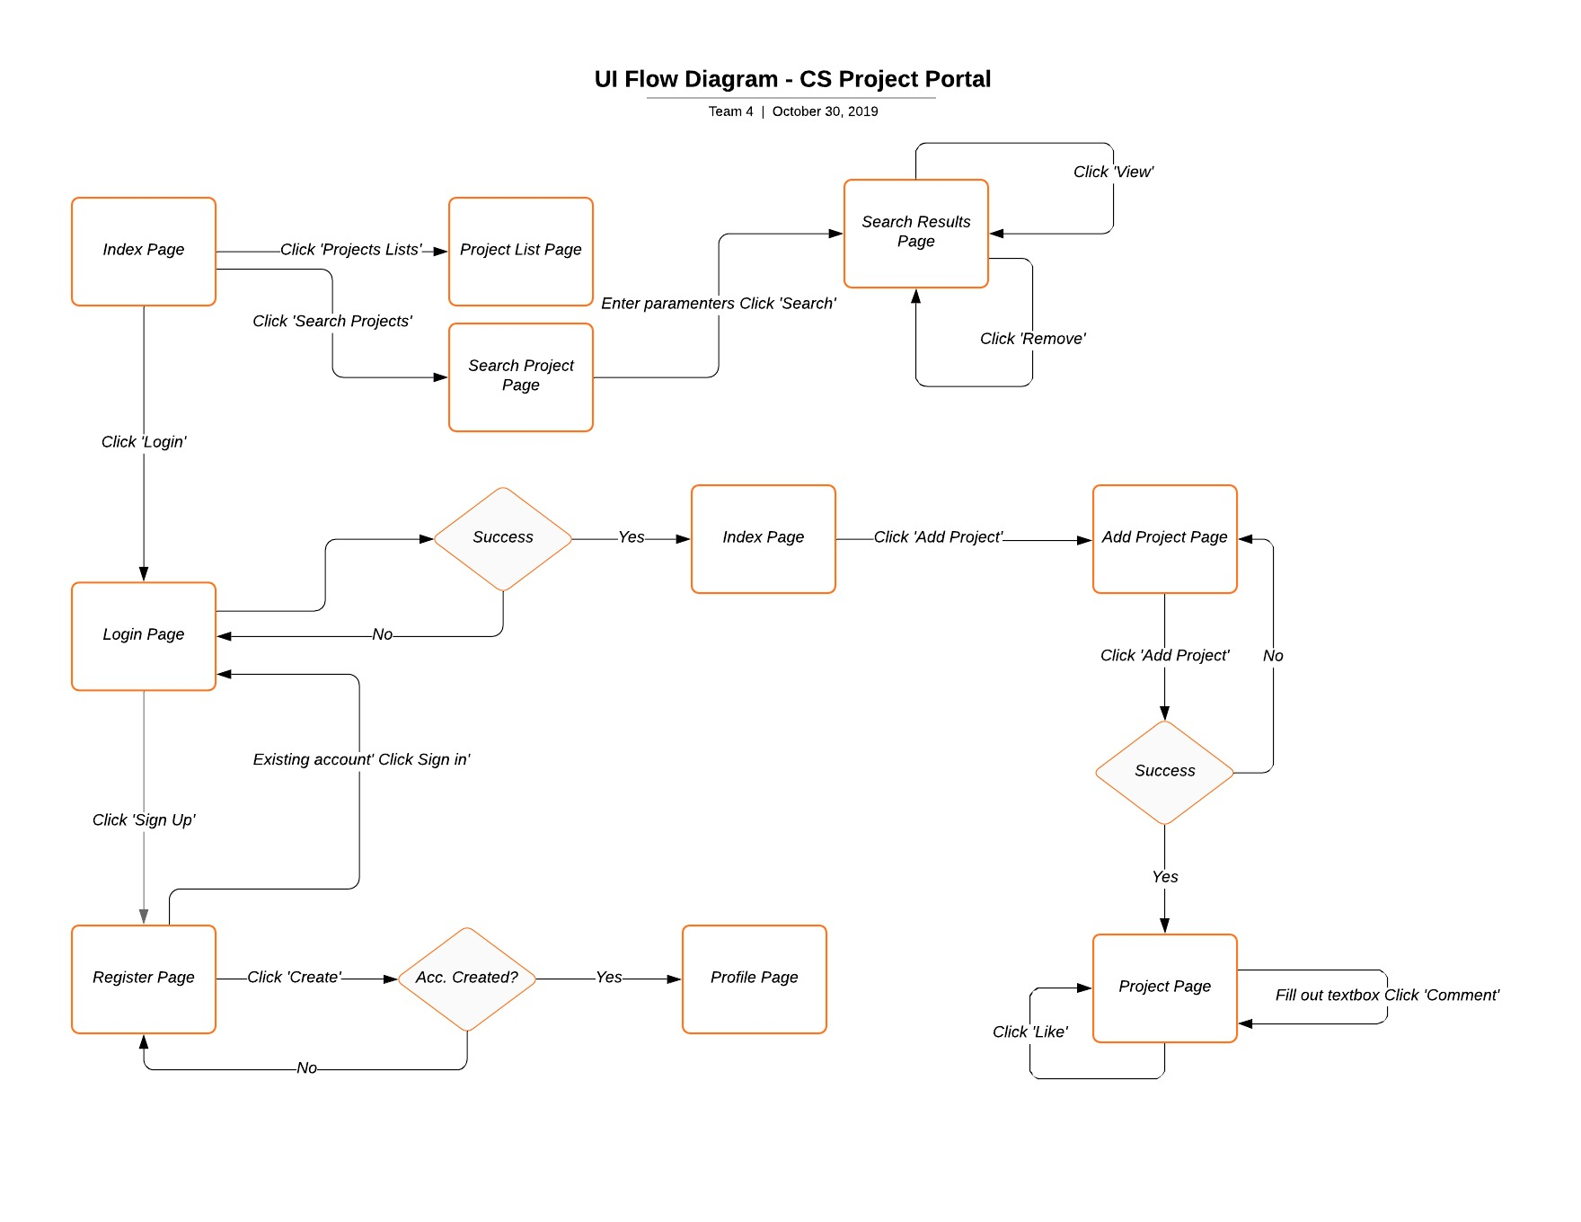
UI Flow Diagram
Notes:
J

Slide 8
Security Achievement
Be able to encrypt and decrypt password via hash algorithm . The user info is stored in the hash password in the database.
All deployed files on the server is encrypted. All the files and elements is hiding from the client side.
Thing to be concern for a security
SQL injection is still not prevent yet. The intruder can be exploited the user info from the database.

Slide 9
Next iteration Plan
Implement view project page in with new site design
Rebuild search project page (functionality still in place)
Finalize testing and implement all input validation

Slide 10
Live Demo

Slide 11
Back-Up Slides

Slide 12
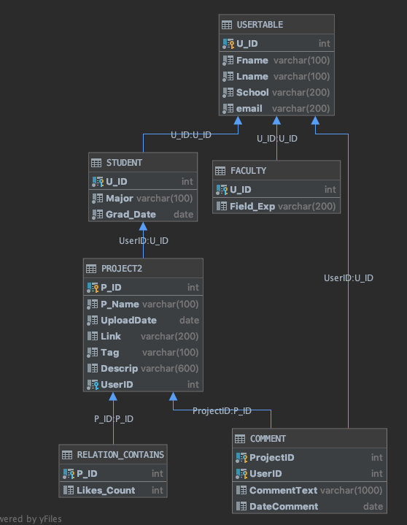
DESIGN ARCHITECTURE
DB Architecture fully implemented in MS SQL Server
Developed and implemented constraints to avoid data anomalies
Sample tuples created to display functionality
Pending SQL Unit Testing with tuples
Notes:
J

Slide 13
Site Deployment Steps
Bought domain name for $10 a year: http://www.computerscienceprojectportal.com
Was already subscribed to a hosting service form Arvixe. They deploy the site to the domain, and give us:
FTP to files of the server
SQL databases
There are separate logins for the FTP and Database.
As well as different software to access them. We use Microsoft SQL Server Management Studio for sql and Atom as an IDE for html pages.
Every time we are comfortable with code in master branch, Files are migrated to our server.
Then test the new files on the server.
Notes:
J

Slide 14
Coding Smell
Bad Smells
Large Class
Duplicate code
Long Parameter Lists
Lack of comments
Files organization doesn’t not reflect site architecture
Notes:
R

Slide 15
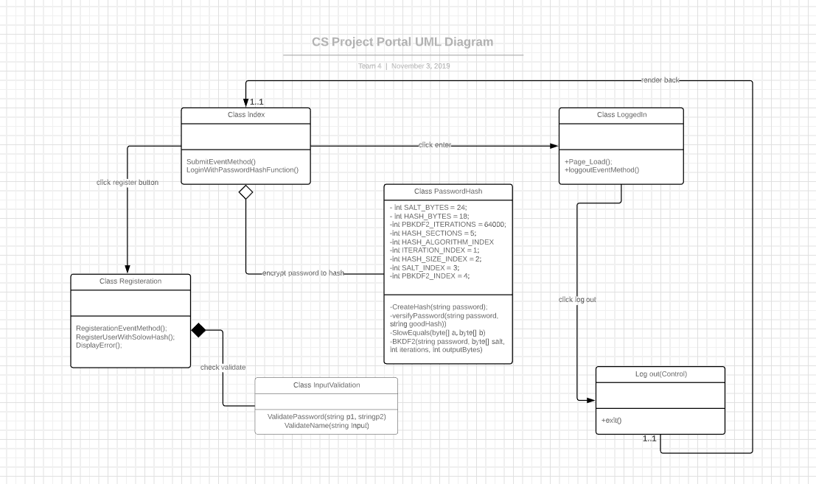
Design Pattern and Site Architecture (3 Tier)
Design Pattern:
The team has implemented structural design patterns at the database design level to organize two different types of users, which can be students and faculty. Users will have their respective distinctive attributes at the subclass level (STUDENT and FACULTY), and common attributes at the super class level USER.
Site Architecture
1. Presentation layer (Users Browser):
a. HTML
b. Java Script
c. Jquery
d. Css
2. Application Layer
a. C# , Rasor
b. Communicates to presentation layer via URL Querying
3. Data Layer
a. Sql server. Receives commands from Application Layer.
Notes:
J

